Slide 1
ANN and Perceptron
Course Code: CSC 4254
Course Title: Computer Vision & Pattern Recognition
Dept. of Computer Science
Faculty of Science and Technology
Lecture No: | 4 | Week No: | 2 | Semester:
Lecturer:

Slide 2
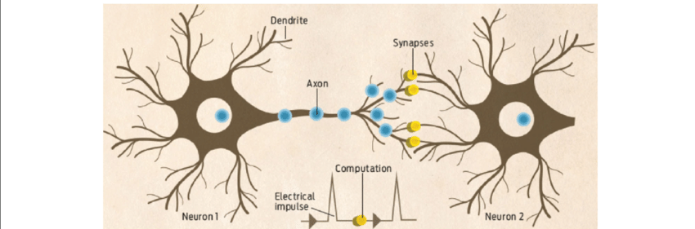
Understanding Human Neuron

Slide 3
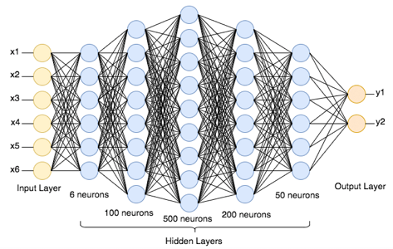
Artificial Neural Network
Input Layer: The input layer receives the input features from the dataset and passes them to the next layer without performing any computation.
Hidden Layer(s): Hidden layers process the inputs using weights, biases, and activation functions to learn patterns in the data.
Output Layer: The output layer produces the final prediction of the network based on the learned information.

Slide 4
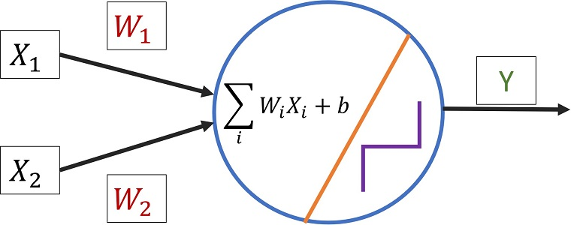
Simplest ANN
Perceptron
Simplest type of artificial neural network
Consists of a single neuron
Takes weighted inputs, adds bias, and applies an activation function
Commonly used for binary classification
Proposed by Frank Rosenblatt in 1957
One of the earliest machine learning models
Lecture 2 -
4

Slide 5
Limitation of Perceptron
Can Only Solve Linearly Separable Problems
Only Binary Classification
No Hidden Layers
Hard Threshold Activation (Step)
Lecture 2 -
5

Slide 6
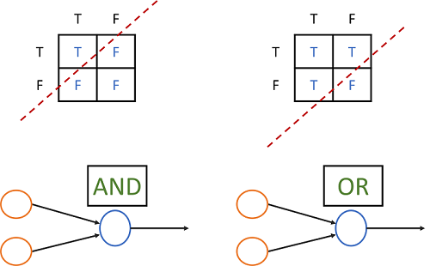
Limitation of Perceptron
Linearly Separable
Can Only Solve Linearly Separable Problems
Only Binary Classification
No Hidden Layers
Hard Threshold Activation (Step)
Lecture 2 -
6

Slide 7
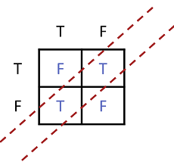
Limitation of Perceptron
Linearly Separable
Can Only Solve Linearly Separable Problems
Only Binary Classification
No Hidden Layers
Hard Threshold Activation (Step)
Linearly Not Separable (XOR)
Lecture 2 -
7

Slide 8
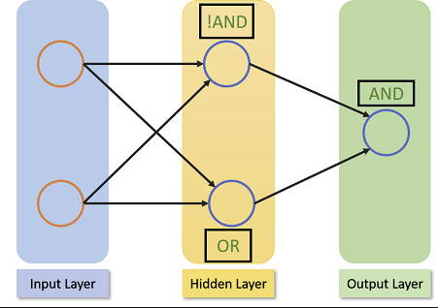
What about this one?
Lecture 2 -
8

Slide 9
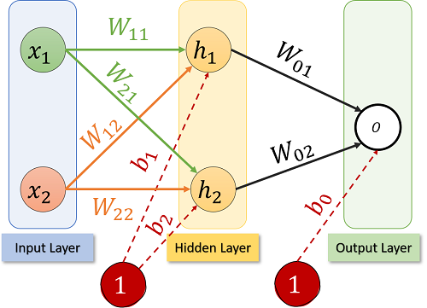
What about this one?
Typical Structure of Neural Network
Lecture 2 -
9

Slide 10
Key Components in Neural Network
Input layers: Receives raw data (features).Number of neurons = number of input features.
Example: For an image of 28×28 pixels → 784 input neurons.
Weights: An adjustable float value of each connection; Weights determine the strength of influence between neurons. Learning = adjusting these weights.
Bias: Added to the weighted sum before activation. Helps shift the activation function. Improves flexibility of the model.
a=w1​x1​+w2​x2​+...+b
Lecture 2 -
10

Slide 11
Key Definitions in Neural Network
Activation Function: Introduces non-linearity so the network can learn complex patterns. Without activation functions, the network behaves like a linear model.
Hidden Layers: Layers between input and output. Extract patterns and features. More layers → deeper network → can model complex relationships.
Output Layer: Produces final prediction.
Loss Function: Measures how wrong the prediction is.
Binary Cross-Entropy (binary classification)
Categorical Cross-Entropy (multi-class)
Mean Squared Error (regression)
Lecture 2 -
11

Slide 12
Key Definitions in Neural Network
Feed Forward: Inputs come in, you take the weighted sum, add the bias, and finally pass it through the activation function. That results feed forward through the network and gets to the output.
Optimization Algorithm: Updates weights to reduce loss. E.g Gradient Descent, SGD etc
Backpropagation: Algorithm used to compute gradients. Applies chain rule to update weights efficiently.
Learning Rate: Controls how big each weight update step is.
Too high → unstable
Too low → slow learning
Epoch: One complete pass of the entire training dataset through the neural network, Includes: feedforward + loss calculation + backpropagation + weight update
Lecture 2 -
12

Slide 13
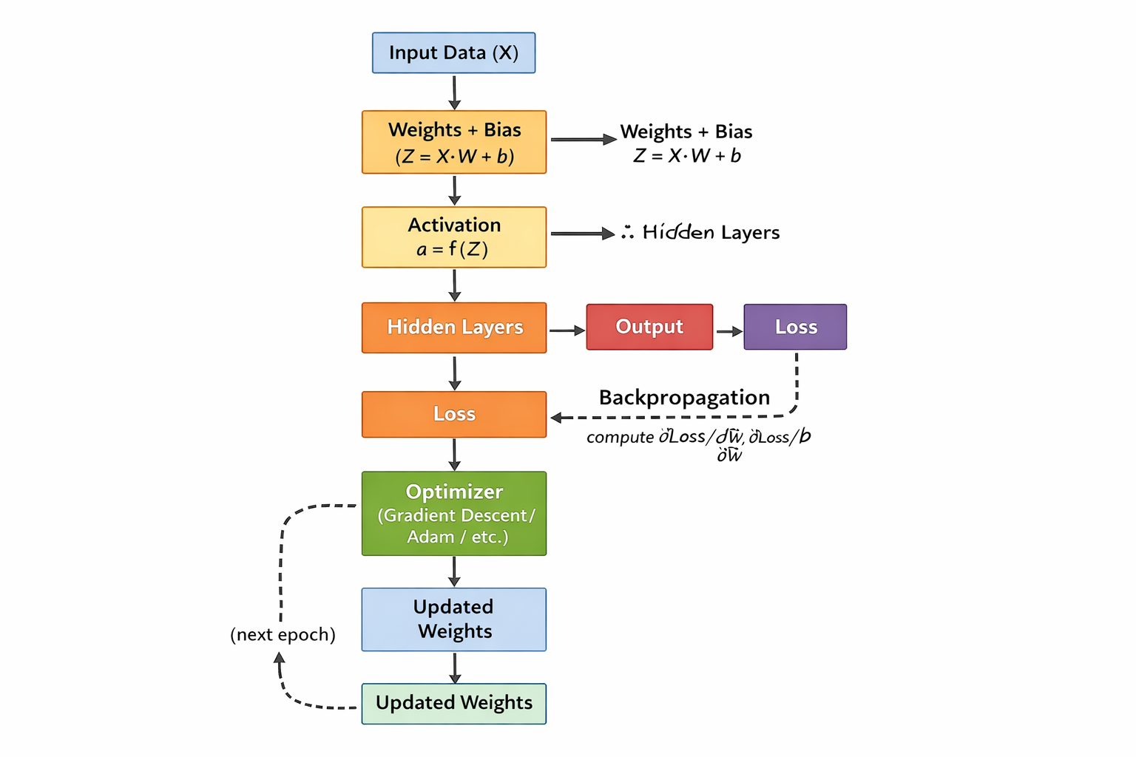
Summary of Training a Network
Lecture 2 -
13

